Slide 1

Building AI & Data products

Slide 2

Meet Anshu Pandey
Co-founder & Head of Technology at Blue Data Consulting | Trainer, Speaker & Consultant for Data and AI
A Tech Enthusiast with Expertise in AI, data, and automation projects.
12+ years of experience, Worked on multiple AI, Automation, and Data projects for telecom, banking, finance, defense clients. Helped enterprises in designing project architecture, managing, mentoring, and monitoring ongoing projects.
Having experience in working with developing RPA solutions, ML cloud services, deploying ML projects, auditing, and testing ML solutions.

Slide 3

What makes an data driven organization?
- strategic Data Acquisition
- Unified data warehouses
Data driven decisions
Pervasive automation with use of AI
New roles – MLE

Slide 4
Pre- requisites to start with Analytics
Transform your business processes to digital
Integrate right data strategy with each digital solution
Align business goals with data strategy, build an AI & Analytics vision

Slide 5
Identify right analytics & data goals
Most promising Analytics solutions
Overlap of both
Analyse technical and financial feasibility
Business Problems
List most important challenges in the business
List top business growth path
What AI can do?
List possible AI integrations
List possible analytics solutions business can adapt

Slide 6
How to start?
Level 1
Build analytics culture
Start Excel analytics, reporting practices

Slide 7
How to start?
Level 2
Start pilot, educate stakeholders, let stakeholders trust analytics and AI solutions
Level 1
Build analytics culture
Start Excel analytics, reporting practices

Slide 8
How to start?
Level 3
Invest wisely in infrastructure, tools, training internal stakeholders, identify right AI goals
Level 2
Start pilot, educate stakeholders, let stakeholders trust analytics and AI solutions
Level 1
Build analytics culture
Start Excel analytics, reporting practices

Slide 9
How to start?
Level 4
Start building and buying AI solutions, rollout projects, integrate AI & analytics with business processes, - AI company
Level 3
Invest wisely in infrastructure, tools, training internal stakeholders, identify right AI goals
Level 2
Start pilot, educate stakeholders, let stakeholders trust analytics and AI solutions
Level 1
Build analytics culture
Start Excel analytics, reporting practices

Slide 10
AI & data Project Lifecycle

Slide 11
Analytics lifecycle
How an enterprise starts consuming data & analytics?
Descriptive Analytics / Business Intelligence
What is happening now?
Data Visualization, statistics
PowerBI, Grafana, Tableau, Excel

Slide 12
Analytics lifecycle
How an enterprise starts consuming data & analytics?
Root Cause Analytics / Exploratory Analytics
Why it happened in the past?
Statistics, Data Visualization
Python, R
Descriptive Analytics / Business Intelligence
What is happening now?
Data Visualization, statistics
PowerBI, Grafana, Tableau, Excel

Slide 13
Analytics lifecycle
Predictive Analytics
How an enterprise starts consuming data & analytics?
What will happen tomorrow?
Supervised Machine Learning
Python, pyspark, R, Cloud tools
Root Cause Analytics / Exploratory Analytics
Why it happened in the past?
Statistics, Data Visualization
Python, R
Descriptive Analytics / Business Intelligence
What is happening now?
Data Visualization, statistics
PowerBI, Grafana, Tableau, Excel

Slide 14
Analytics lifecycle
Prescriptive Analytics
How can we make it happen?
Unsupervised Machine Learning
Big data tools, cloud platforms
How an enterprise starts consuming data & analytics?
Predictive Analytics
What will happen tomorrow?
Supervised Machine Learning
Python, pyspark, R, Cloud tools
Root Cause Analytics / Exploratory Analytics
Why it happened in the past?
Statistics, Data Visualization
Python, R
Descriptive Analytics / Business Intelligence
What is happening now?
Data Visualization, statistics
PowerBI, Grafana, Tableau, Excel

Slide 15
Data product Framework
Data Exploration, Domain Knowledge, gather more relevant data from business or from outside
Data Cleaning - check for missing values, check for duplicates, check for un realistic values
Feature Engineering
Feature Extraction - extract important information from data
Feature Selection - select the more important feature to predict label
Pre-processing - changing format of data so that it can be processed by Machine Learning algorithm
Apply Machine Learning Algorithm
Performance Analysis
Tuning - improvement in performance of ML Model
Export the trained model for production
Deployment to Production
Monitoring of performance in Production

Slide 16
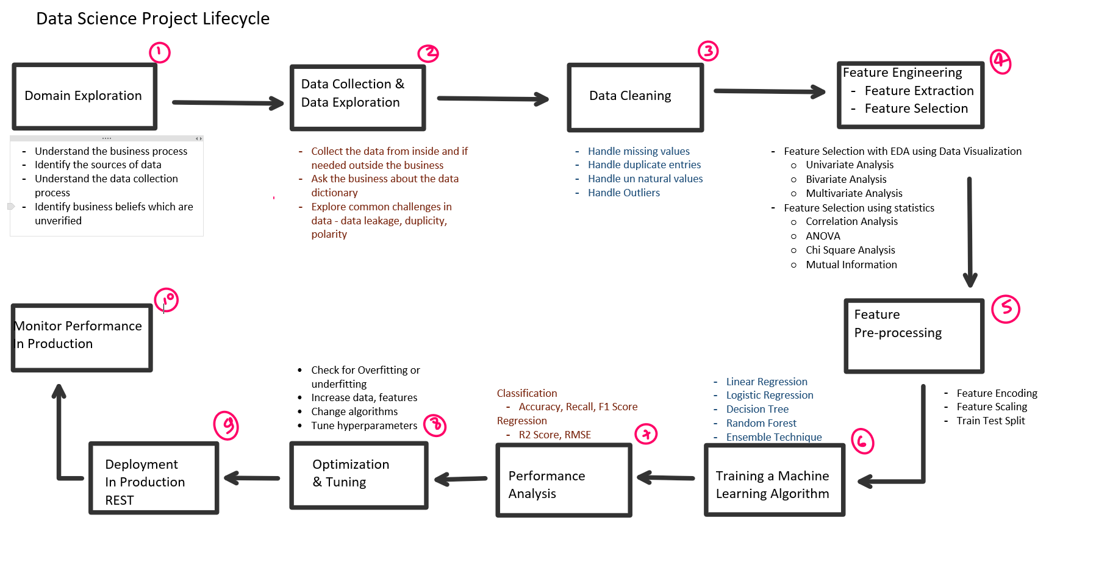

Slide 17
Feature Selection Best Practices
Data Visualization
Correlation Analysis
Variability Analysis
ANOVA
Chi Square Test
Clustering Analysis
Mutual information
Feature Importances
Lasso
Backward and Forward Chaining

Slide 18
Phases of ML Project
Research Stage
Development Stage

Slide 19
Stages of an ML Project
Research Stage
Development Stage
Questions at different Stages
Exploratory in nature with an unknown answer in most cases. What data is available? Is this data directly relevant to the problem? What ML methods(s) should we try? What metric should be used to measure success? Is it possible to…? Surely, we must be able to…. | The method for solving the problem is now known. How do we implement this method at scale? How do we pipe the data into the model in a timely fashion? How do we collect, store and transform data so models can be retrained consistently, and accurate predictions can be calculated within a required SLA? How do we build an A/B testing environment, in order to test future model iterations?

Slide 20
Verify Assumptions
Variables relevant to the problem are captured and available in the data.
Training, validation, and test sets adequately represent reality.
Training, validation, and test data captured at a point in time remains valid.
Training, validation, and test data captured at a point in time remains valid.

Slide 21
Verify Assumptions
Transfer learning assumes that the source model is appropriate and the learning is indeed transferable.
The correlations found are relevant. For example, the divorce rate in Maine is highly correlated with per capita consumption of margarine. Is this relevant to the problem?13 Correlation is not causation.

Slide 22
Verify Assumptions
An ML model can be built and deployed in production within the time constraints imposed by management or the business case. If not, other avenues should be considered, or the time constraint should be relaxed.
Concept drift or model drift happen relatively slowly, or can be adequately corrected with model retraining while still supporting the economic model.
Operational ownership is economically justified. The overall economic upside of the system justifies the cost of hiring the ML skills, labeling data or researching errors, maintaining the model, identifying model drift when it occurs, and retraining as necessary

Slide 23
Data Quality
The quality of the ML model directly depends on the quality of the data used to build it.
A significant portion of the research component of ML projects is to assess the data quality and whether it’s appropriate for the problem.
While assessing data quality is still more of an art than a science, some helpful methods include:
Documenting the data catalog and pipeline
Estimating the impact of data quality

Slide 24
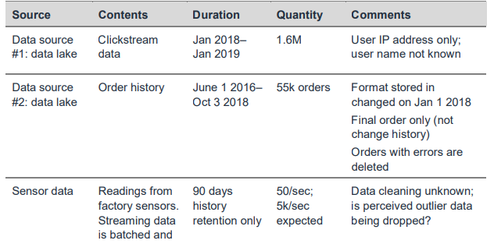
Sample data catalog during research stage

Slide 25
Best practices for ML Project
Staffing the project appropriately
Assessing economic value
Using scorecards as a risk management technique
Using incremental investment approaches

Slide 26
Best practices for ML Project
Staffing the project appropriately
Assessing economic value
Using scorecards as a risk management technique
Using incremental investment approaches
Most ML projects are staffed by people considered specialists in this definition.
These specialists can be further refined into data scientists and data engineers:
Data scientists frequently have backgrounds in applied math, statistics background, and perform advanced analytics
Data engineers frequently have backgrounds in programming and analysis, and specialize in big data technologies

Slide 27
Best practices for ML Project
Staffing the project appropriately
Assessing economic value
Using scorecards as a risk management technique
Using incremental investment approaches
The following roles should be represented on the team
Steering committee – The steering committee must include the business stakeholders and the financial owner of benefits and risks. The committee makes decisions about the direction of the project and its fit to the business opportunities, including potentially canceling a project if the economic model no longer shows positive returns.

Slide 28
Best practices for ML Project
The following roles should be represented on the team
Subject Matter Experts (SMEs) – Project success depends on knowledge of how the data is collected, the systems involved, the pre-processing that’s been performed, sometimes the history of why data is that way, or the embedded assumptions (for example, data values below x are arbitrarily stripped out before they get to this system). This skill set and knowledge is tightly linked to the business processes involved, and the existing systems and methods used to generate the data.
Staffing the project appropriately
Assessing economic value
Using scorecards as a risk management technique
Using incremental investment approaches

Slide 29
Best practices for ML Project
Staffing the project appropriately
Assessing economic value
Using scorecards as a risk management technique
Using incremental investment approaches
The following roles should be represented on the team
Data scientists – These specialists provide statistical and ML specialty knowledge. They build more complex ML models, and perform statistical evaluation of model performance. Rigorous experimental design is critical, particularly for companies with large user bases or in highly regulated industries.

Slide 30
Best practices for ML Project
Staffing the project appropriately
Assessing economic value
Using scorecards as a risk management technique
Using incremental investment approaches
The following roles should be represented on the team
Data, application development, and infrastructure engineers – These specialists perform data acquisition, ETL (extract, transform, load), and build the data pipeline. This group includes application developers who own integrating the model into an application, and using the inferences in the context of a business process

Slide 31
Best practices for ML Project
Staffing the project appropriately
Assessing economic value
Using scorecards as a risk management technique
Using incremental investment approaches
A key first step in your ML project is to build an economic model of the expected value from the project.
This model will provide context to inform project decisions, moving the focus from the ML technology to its impact on the business.

Slide 32
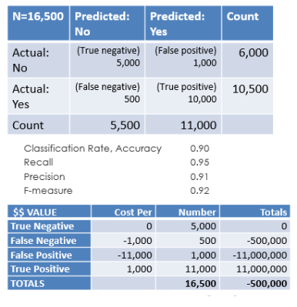
Best practices for ML Project
Staffing the project appropriately
Assessing economic value
Using scorecards as a risk management technique
Using incremental investment approaches

Slide 33
Best practices for ML Project
Staffing the project appropriately
Assessing economic value
Using scorecards as a risk management technique
Using incremental investment approaches
A major component of project management is risk management.
Scorecards are a deceptively simple mechanism that can be used to identify, manage, and report on risks.

Slide 34
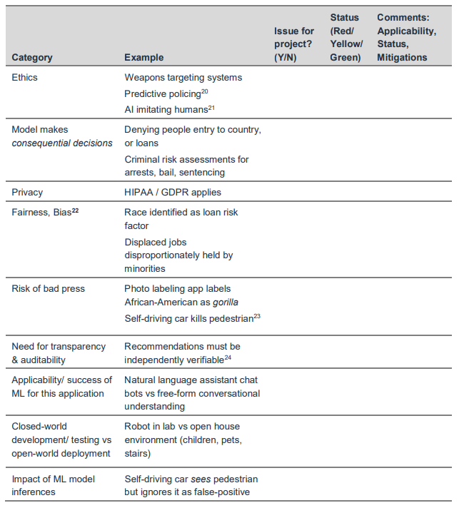
Best practices for ML Project
The Project Context scorecard addresses the social, business, and regulatory environment of the project.
Staffing the project appropriately
Assessing economic value
Using scorecards as a risk management technique
Using incremental investment approaches

Slide 35
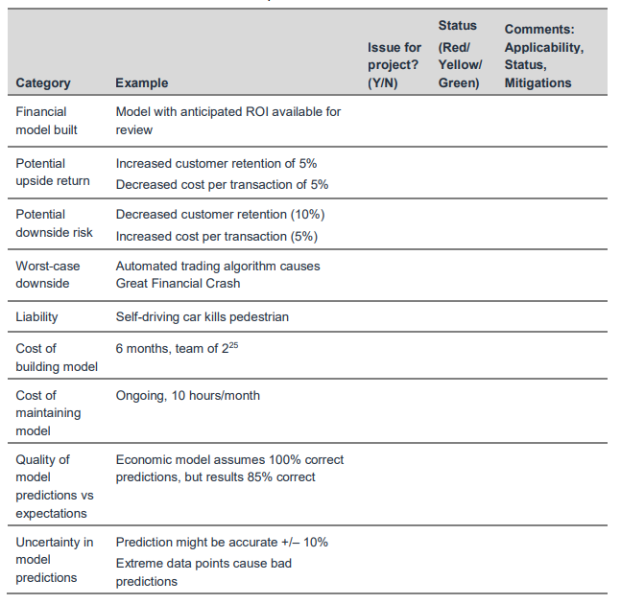
Best practices for ML Project
The Financial scorecard identifies the costs and benefits of the problem you are trying to solve with ML, and of the ML system you are developing.
Staffing the project appropriately
Assessing economic value
Using scorecards as a risk management technique
Using incremental investment approaches

Slide 36
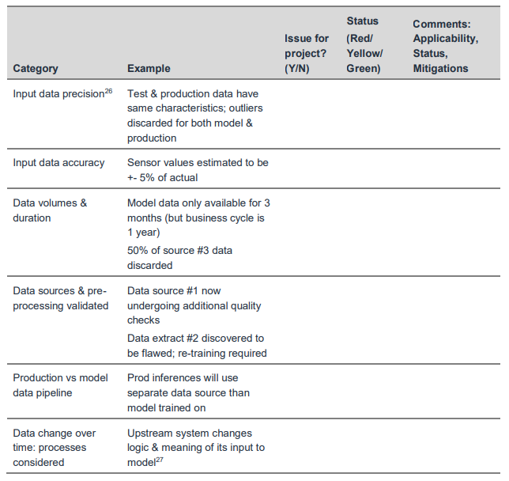
Best practices for ML Project
The Data Quality scorecard highlights areas that are frequently problematic in ML projects, and that can easily mislead the project.
Staffing the project appropriately
Assessing economic value
Using scorecards as a risk management technique
Using incremental investment approaches

Slide 37
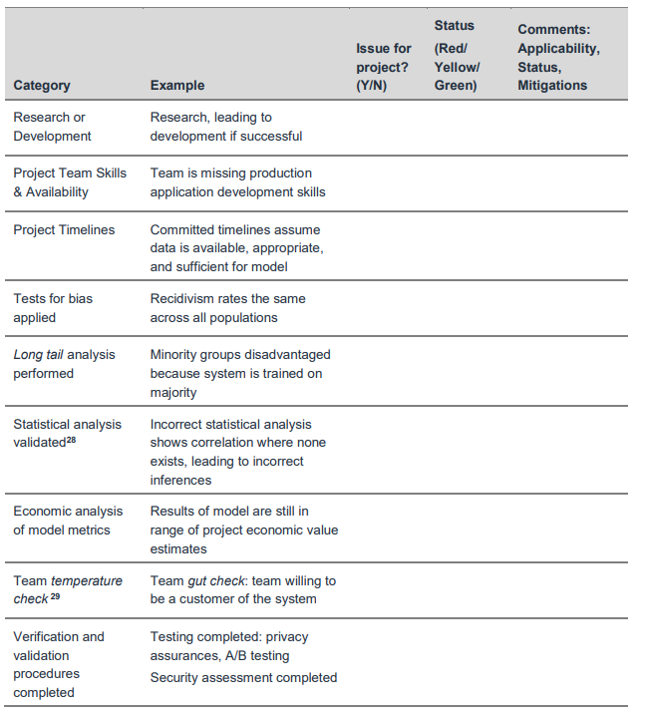
Best practices for ML Project
Staffing the project appropriately
Assessing economic value
Using scorecards as a risk management technique
Using incremental investment approaches
The Project Processes scorecard addresses processes in the ML project that are easily overlooked in the excitement of developing & testing the algorithm and identifying promising results.

Slide 38
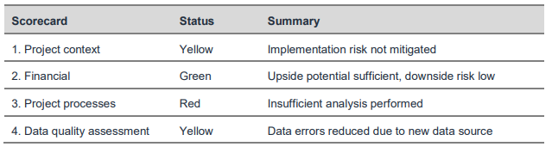
Best practices for ML Project
The Summary scorecard captures the key risk areas to bring to executive attention. It can be prepared for presentation to the steering committee and other interested executives
Staffing the project appropriately
Assessing economic value
Using scorecards as a risk management technique
Using incremental investment approaches

Slide 39
Best practices for ML Project
Staffing the project appropriately
Assessing economic value
Using scorecards as a risk management technique
Using incremental investment approaches
The suggested approach is to take an incremental investment approach to ML projects, and regular reviews with the steering committee or responsible management.
The inputs to the review include:
Document the current assessment, status, and mitigation plans
Present the summary scorecard and detailed scorecards
Present the latest data pipelines used for model development and for production
Reassess expected benefits and risk factors when you have new knowledge or updates
Provide a recommendation on the future course of the project, based on prior items

Slide 40
How to build data product team?

Slide 41
Provide AI Training to teams
Role | Training
Executives and Senior Business leaders | - What AI can do for your enterprise - AI Strategy - Resource Allocation
Leaders of divisions working on AI projects | - set project direction (technical and business diligence) - Resource allocation - Monitor Progress
AI Engineers trainees | - Build and ship AI Software - Gather data - Execute on specific AI Projects

Slide 42
Provide AI Training to teams
Online training
In house training and seminars
Books and self learning

Slide 43
Develop AI Strategy
Leverage AI to create an advantage specific to your industry sector
Design strategy aligned with the Virtuous Circle of AI
Considering creating a data strategy
Strategic data acquisition
Unified data warehouse
create network effects and platform advantages
in industries with "winner take all" dynamics

Slide 44
Develop internal and external communication
- Investor relations
- Government relations
- Consumers / User education
- Talent / recruitment
Internal communications
so that investors and all stakeholders can have idea of how the company is moving towards adaption of AI

Slide 45
Roles in an AI Team
Software Engineers
Execution of Task
Machine Learning Engineers
Machine Learning Researcher
Extended state-of-art in ML
Applied ML Scientist
Combination of MLE and MLR

Slide 46
Roles in an AI Team
Data Engineers
organize data
Make sure data is saved in easily accessible, secure and cost-effective way
AI Product Manager
identifying feasible products, help decide what to build; whats valuable
Data Scientist
exanine data and provide insights
make presentations to team/ executive | MLE

Slide 47
Technical tools for AI Teams
Machine Learning frameworks –
tensorflow
PyTorch
Keras
scikit-learn
MXNet
CNTK
caffe
paddlepaddle
R
Weka

Slide 48
Technical tools for AI Teams
Infrastructure
CPU v/s GPU
CPU: Computer Processor (Central Processing Unit)
GPU: Graphics Processing Unit
Cloud v/s On-premises

Slide 49
Trends and Best Practices

Slide 50
More data beats better algorithms

Slide 51
For customer-based products – UI (the only interface of ML model to users) matters the most.

Slide 52
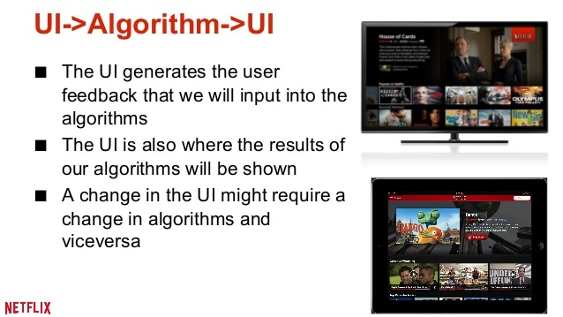

Slide 53
Implicit signals beat explicit

Slide 54
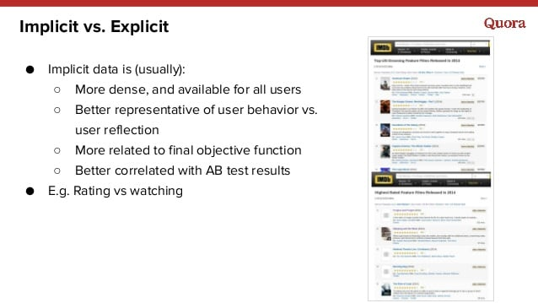

Slide 55
Technology adaption for AI & Data teams

Slide 56
Algorithm | Problem Type | Results interpretable by you? | Easy to explain algorithm to others? | Average predictive accuracy | Training speed | Prediction speed | Amount of parameter tuning needed (excluding feature selection)
KNN | Either | Yes | Yes | Lower | Fast | Depends on n | Minimal
Linear regression | Regression | Yes | Yes | Lower | Fast | Fast | None (excluding regularization)
Logistic regression | Classification | Somewhat | Yes | Lower | Fast | Fast | None (excluding regularization)
Naive Bayes | Classification | Somewhat | Somewhat | Lower | Fast (excluding feature extraction) | Fast | Some for feature extraction
Decision trees | Either | YES | Yes | Average | Fast | Fast | Some
Random Forests | Either | A little | No | Higher | Slow | Moderate | Some
Neural networks | Either | No | No | Higher | Slow | Fast | Lots

Slide 57
Algorithm | Performs well with small number of observations? | Handles lots of irrelevant features well (separates signal from noise)? | Automatically learns feature interactions? | Gives calibrated probabilities of class membership? | Parametric? (Linear) | Features might need scaling?
KNN | Yes | No | No | Yes | No | Yes
Linear regression | Yes | No | No | N/A | Yes | No (unless regularized)
Logistic regression | Yes | No | No | Yes | Yes | No (unless regularized)
Naive Bayes | Yes | Yes | No | No | Yes | No
Decision trees | No | No | Yes | Possibly | No | No
Random Forests | No | Yes (unless noise ratio is very high) | Yes | Possibly | No | No
Neural networks | No | Yes | Yes | Possibly | No | Yes

Slide 58
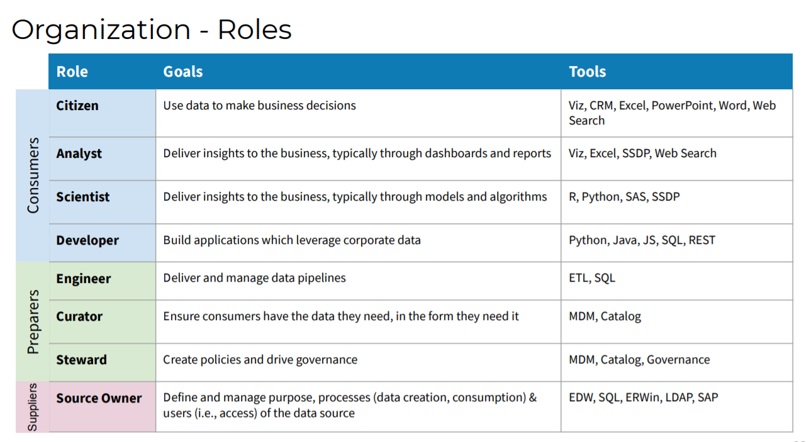

Slide 59

Big Data tools
Big Data Ingestion
Big Data Storage
Big Data Analytics
Big Data Visualization
Apache Kafka, NIFI, AWS Kinesis, Apache Flume, Apache Storm
HDFS, Data Lake Storage, Hbase, MongoDB, Cassandra
Apache Hadoop
Apache Spark
PowerBI, Tableau
Grafana, Qlikview

Slide 60
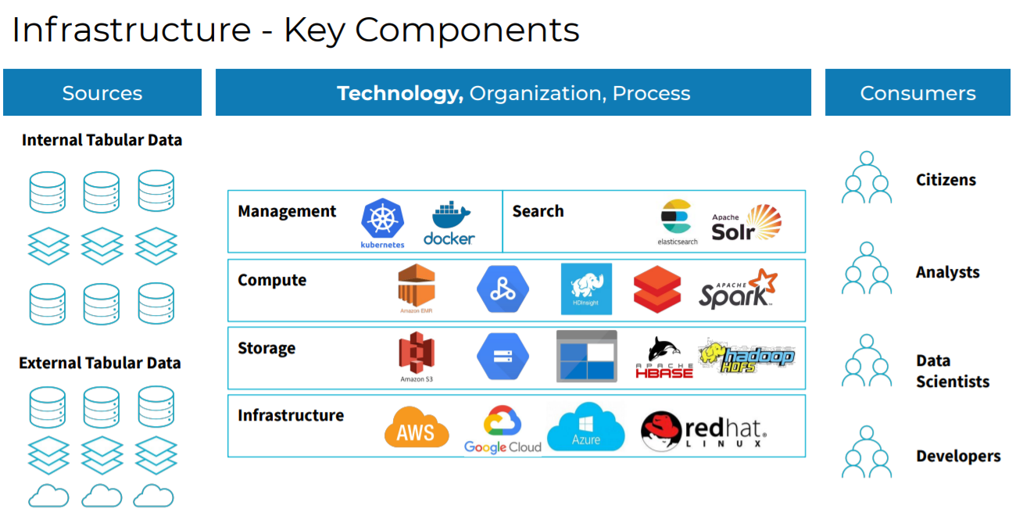

Slide 61
MLOps tools
Model Development: scikit-learn, tensorflow, Pytorch
Model deployment: flask, fast api, Django
Model management: mlflow, Kubeflow
Model Analysis: SHAPE, LIME, fairlearn

Slide 62
Everything need not be developed from scratch.

Slide 63
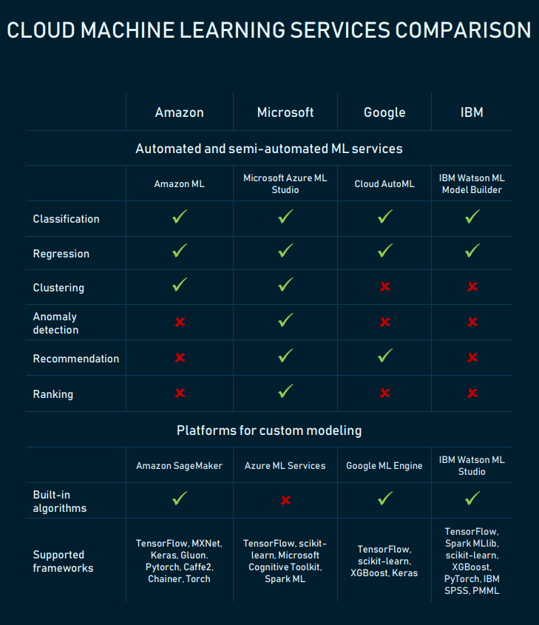
Comparison

Slide 64
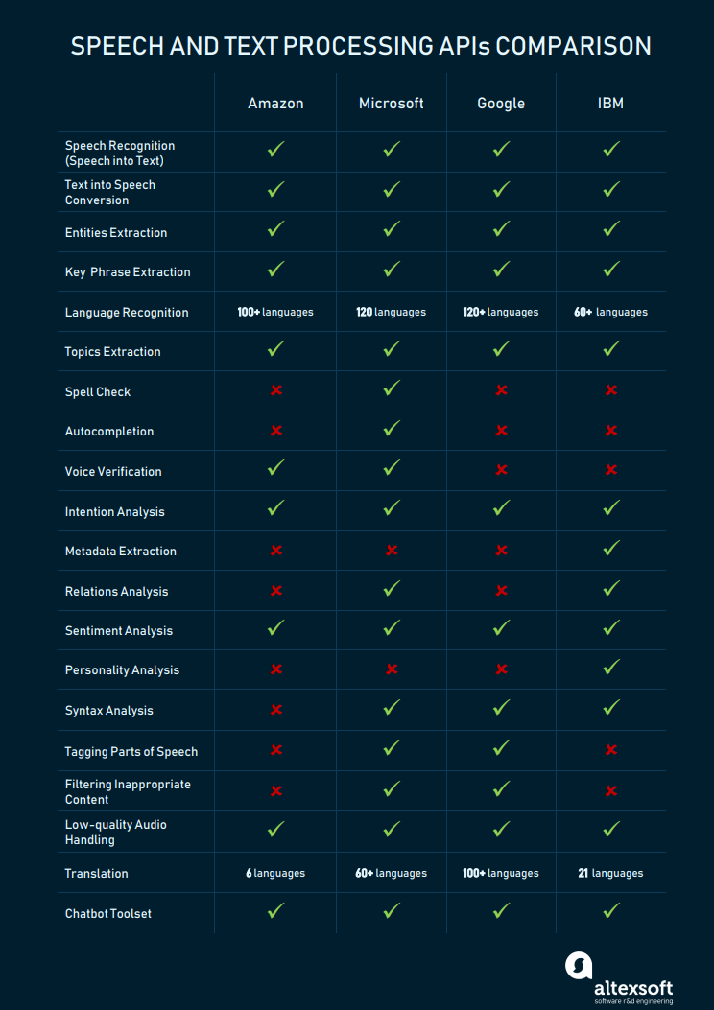
Comparison

Slide 65
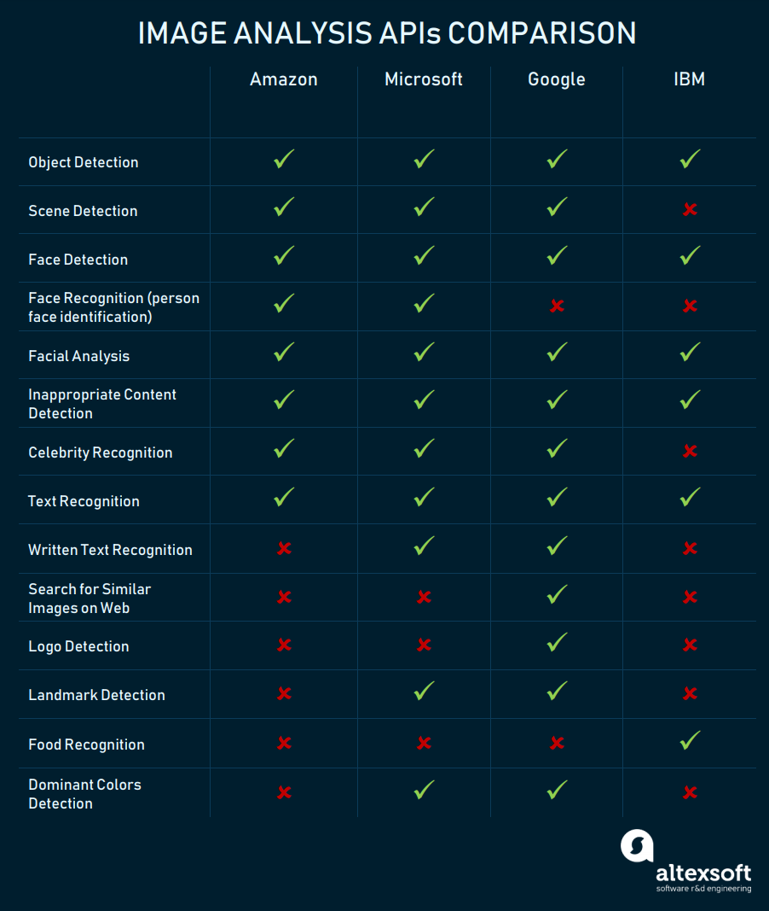
Comparison

Slide 66
#AskMeAnything
#AskMeAnything

